Slide 1
Design Pad
A project by Jacob Bird

Slide 2
What is it?
This project will produce a drawing program like illustrator.
It will draw ovals, circles, rectangles, squares and lines.
It will also have a pen tool for drawing curves and curved shapes.

Slide 3
Who is the program for?
This program is for designers who want a simple draw program.
Web designers can use it to create art for their web pages.
Print designers can use it to create flyers, black and white news paper pictures and black and white magazine art.

Slide 4
What makes this different
The other tools for drawing are overly complex leaving the user to wonder about how to do the simple things.
This program is for the simple things. It is easy to use and even the first time user can accomplish their goals quickly.

Slide 5
Importance to the end user
It is important to the end user to have a draw program that can save a file that can be opened for later use.
Having the ability to move shapes around is also important.
The ability to create in the 2-Dimensional environment is important to the end user.

Slide 6
How will this be made?
This will be written in Java using JavaFx.
The file save system will save to an xml style file and will be auto-save.
The pen tool will use Bezier curves for the drawing of the curves.

Slide 7
Requirements
Easy to use
Intuitive
Draws all of the shapes
Draws a custom shape
Undo functions
Redo functions
Edit functions
File functions
Help functions

Slide 8
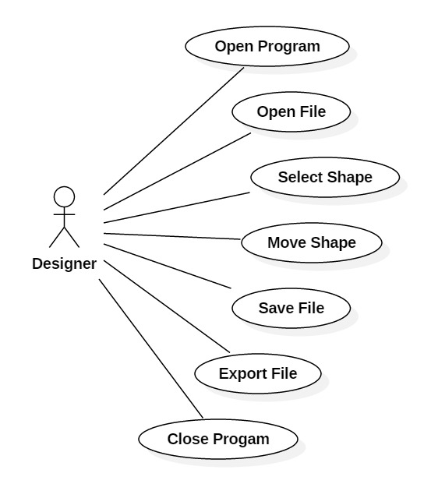
Use Case Sample

Slide 9
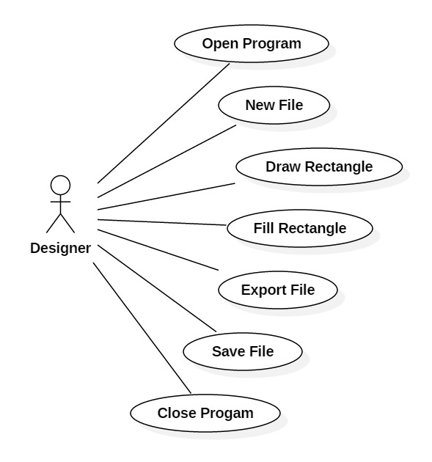
Use Case Sample 2

Slide 10
Buttons
There will be one button for each draw tool.
In addition to the one button for each draw tool there will be a select button with the image of a mouse pointer.
The select button will choose a select tool which allows the user to move the shapes around.
Includes an undo button.

Slide 11
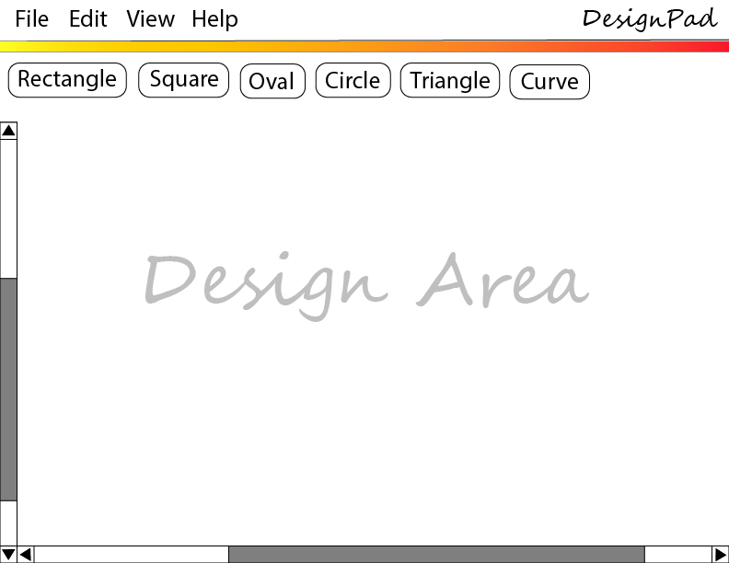
Graphical User Interface

Slide 12
Shapes
Ovals will resize with a box around it and handles at the corners.
Circles will also resize
Rectangles like ovals resize before getting saved.
Squares are the same as rectangles only with equal length sides

Slide 13
Pen tool – step 1
The pen tool draws curves.

Slide 14
Pen tool – Step 2
Connect curves

Slide 15
Pen tool – Step 3
Creating pen tool objects

Slide 16
Design Doc. – Classes and Interfaces
Shapes Interface
Shapes Themselves
Shape Factory
Design Class
GUI Class
Design Memento
Undo/Redo
Save
Export

Slide 17
The Schedule
A Trello board is used to keep the schedule.
Each task is 4-5 days long estimated time.
Predicted over-time for certain tasks is included in the Trello board.
Predicted time for unforeseen problems is also included in the Trello board.
All tasks have an end date

Slide 18
The Idea is expandable
Many additional features may be added if time allows.
Line color
Fill color
Gradients
Filling custom shapes with color
Rotation
Resize

